Slide 1
GCP detection
By: Sean Winklaar and Stijn de Graauw

Slide 2
Contents
Design
Data
Filter
YOLO
Identification

Slide 3
design

Slide 4
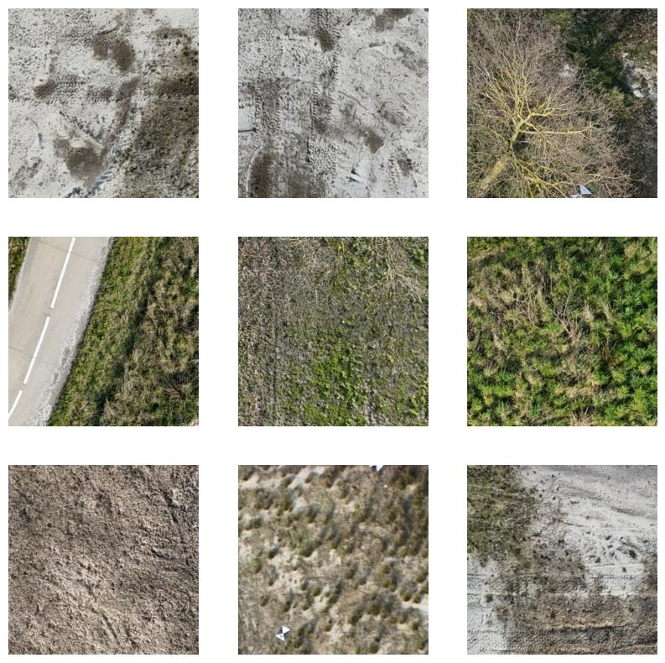
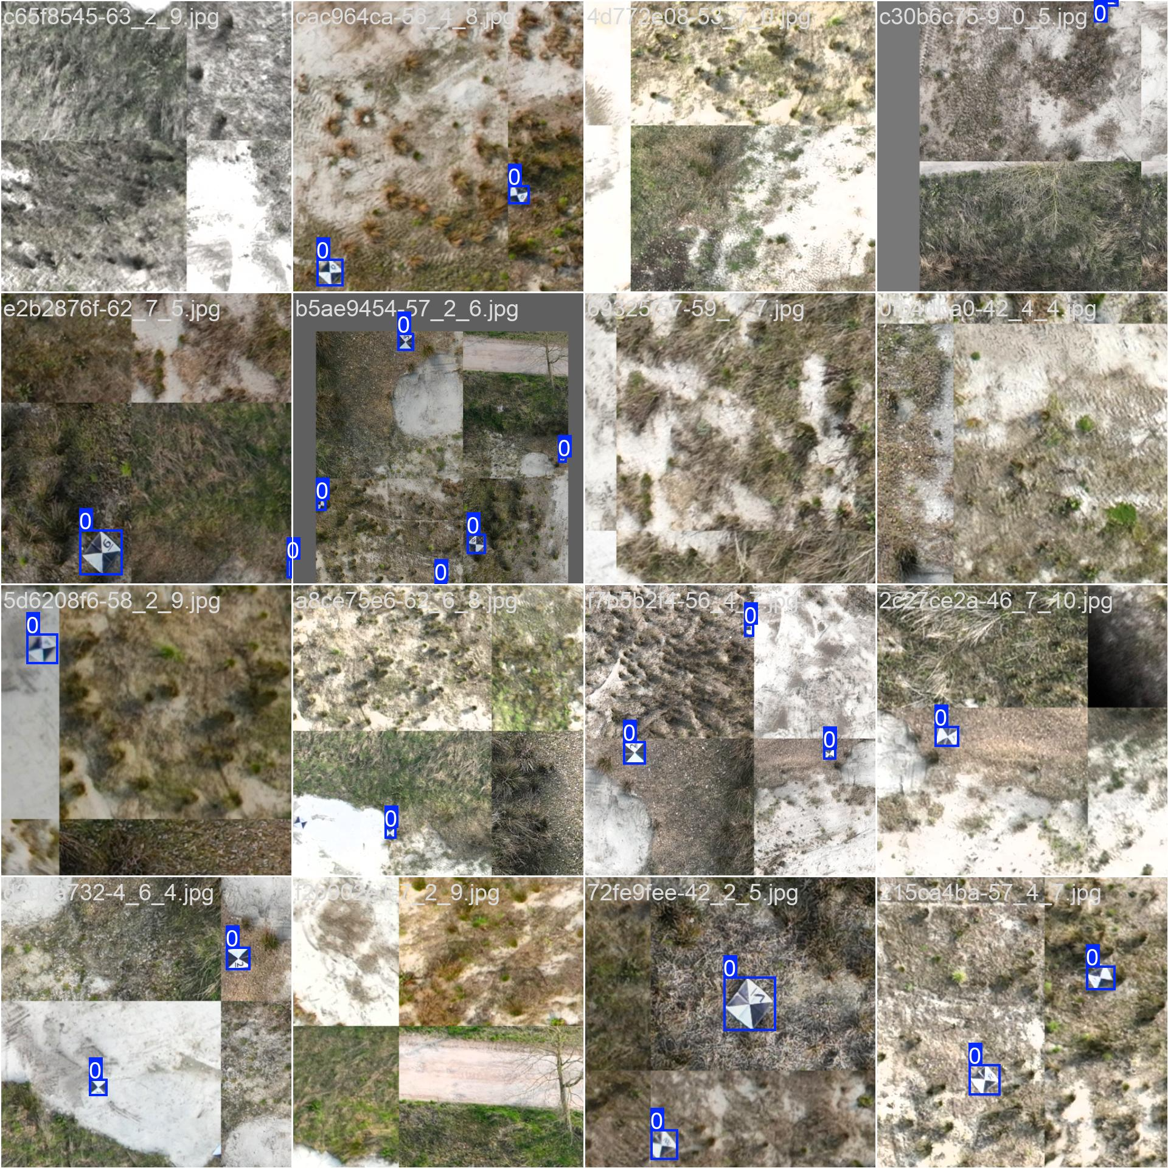
Data
Smart tiling
Synthetic data generation
Annotation

Slide 5
Filter

Slide 6
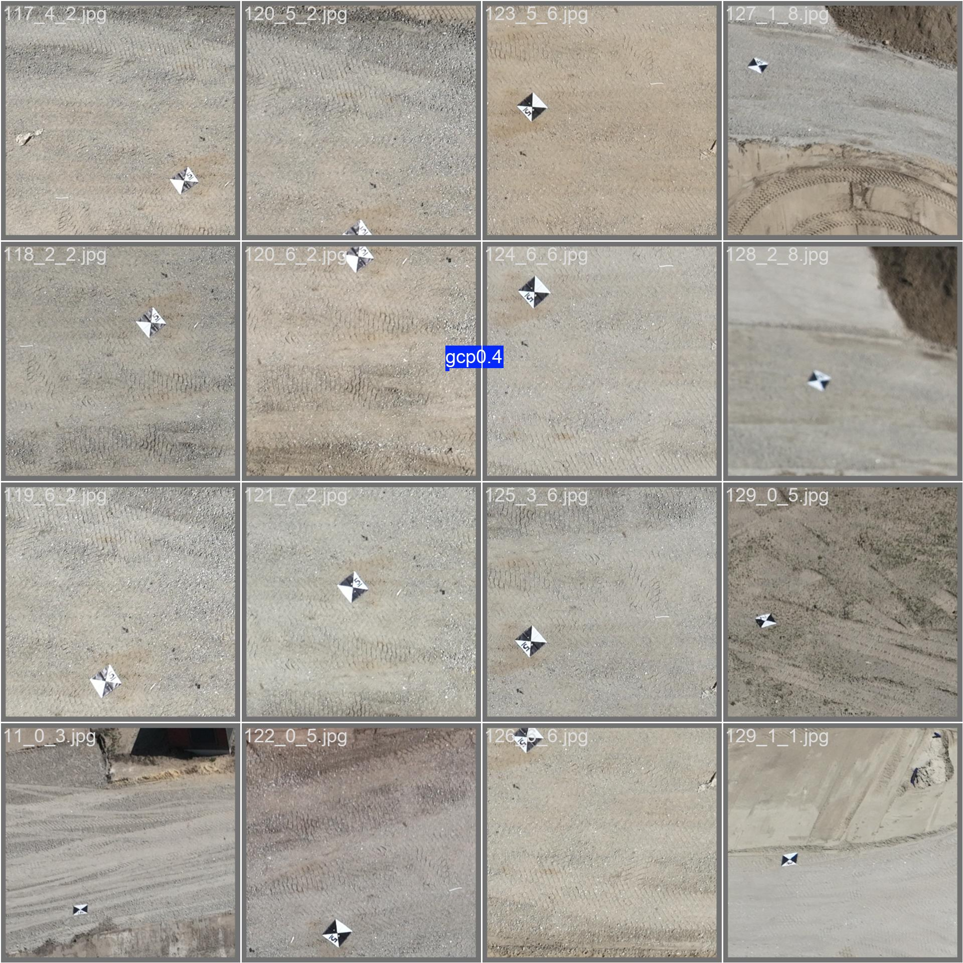
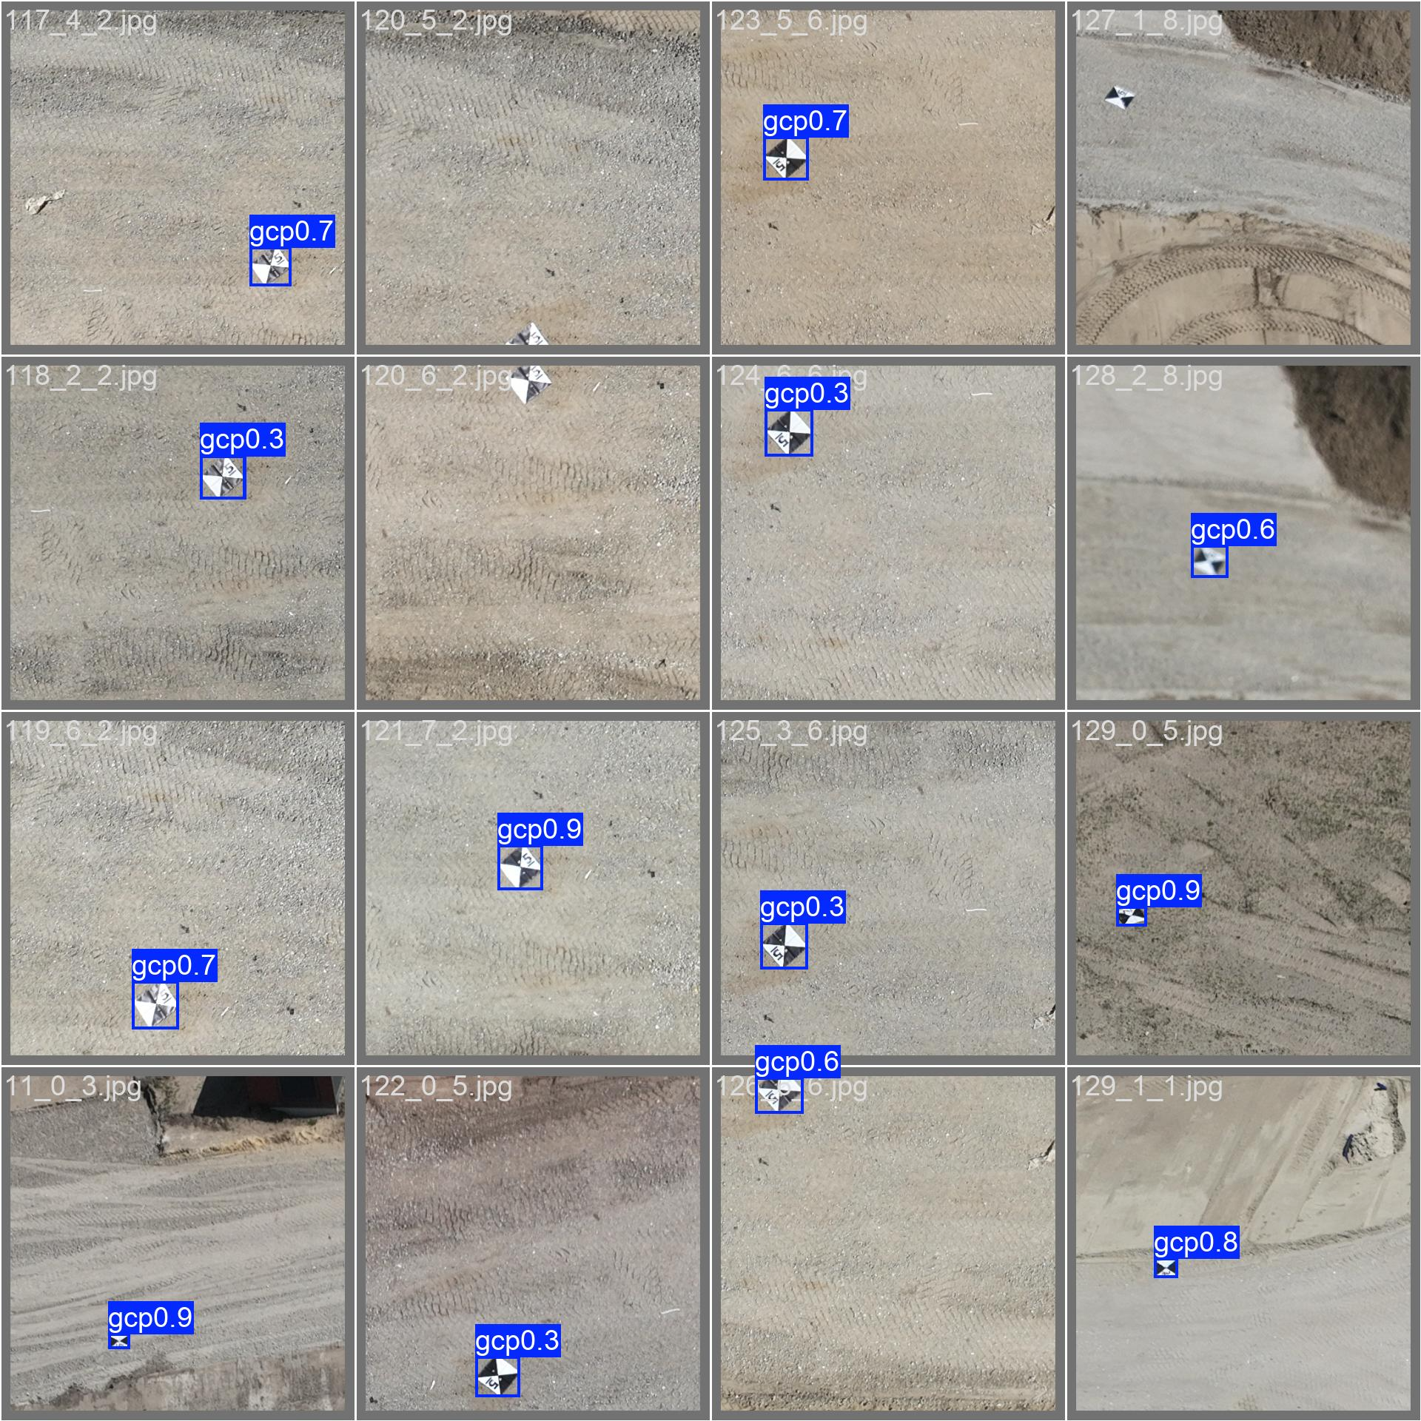
YOLO
yolov8n results
Non tiled
Tiled

Slide 7
YOLO
Poor Performers: YOLOv8n, YOLO26m.
High False Positives: YOLO11x
Top Performer: YOLOv5x

Slide 8
Identification

